Slide 1
Automatic Waste Classification
N01601584: Terry Lay
N01613230: Ruoyu Zhu

Slide 2
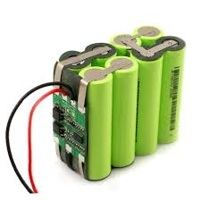
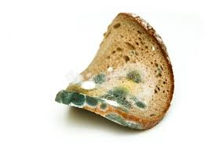
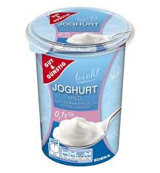
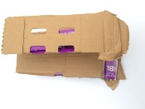
Waste Management
Processes and actions needed to properly dispose of waste
Challenges:
Ineffective recycling and composting
Not all waste can be disposed of in the same manner
Different materials need to be separated before recycling

Slide 3
Waste Segregation
Canadians dispose of over 3 million tonnes of plastic waste annually and only 9% is properly recycled – the rest is thrown into landfills, waste-to-energy facilities or to the environment
It is important to segregate waste appropriately
Improper disposal of wastes and toxins poses health and environmental hazards
Waste segregation improves the quality of recycling, minimizes material that ends up in land fills

Slide 4
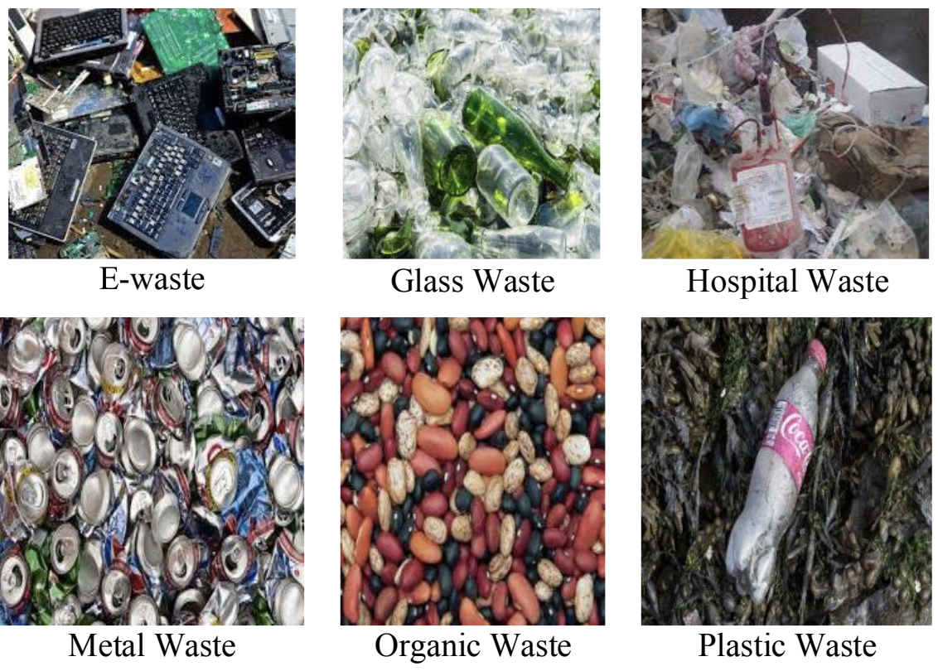
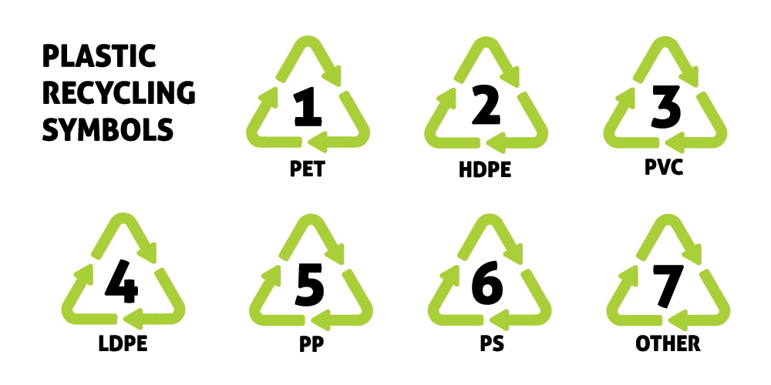
Previous Study
ConvoWaste: classify general types of waste
6 categories of waste
Inception-Resnet V2 model with several extra layers.
98% accuracy
Resin codes from images of plastic waste
7 categories of resin codes from images of plastic waste.
Extracted embeddings of the images, and fit a knn algorithm
high computation costs
99.7% accuracy
Organic waste v.s. Residual waste
2 classes classification problem
Fine-tuned on VGGNet-16 and ResNet-50
96.6% accuracies with ResNet-50
95.6% accuracies with VGGNet-16
Notes:
The Resin Identification Code (RIC) is a system introduced in 1988 in the US as an indicator of the type of material a plastic product is made of. The dataset consisted of 3200 training, 400 testing, and 400 validation images.

Slide 5
Datasets
Category | Number of Images
Brown glass | 607
Green glass | 629
Trash | 697
Metal | 769
White glass | 775
Plastic | 865
Cardboard | 891
Batteries | 945
Biological | 985
Paper | 1050
Shoes | 1977
Clothes | 5325
Total | 15515
The dataset is the Household Garbage Classification dataset from Kaggle.
The dataset is extended to 12 classes of waste categories.
12 classes: paper, cardboard, biological, metal, plastic, green-glass, brown-glass, white-glass, clothes, shoes, batteries, and trash.

Slide 6
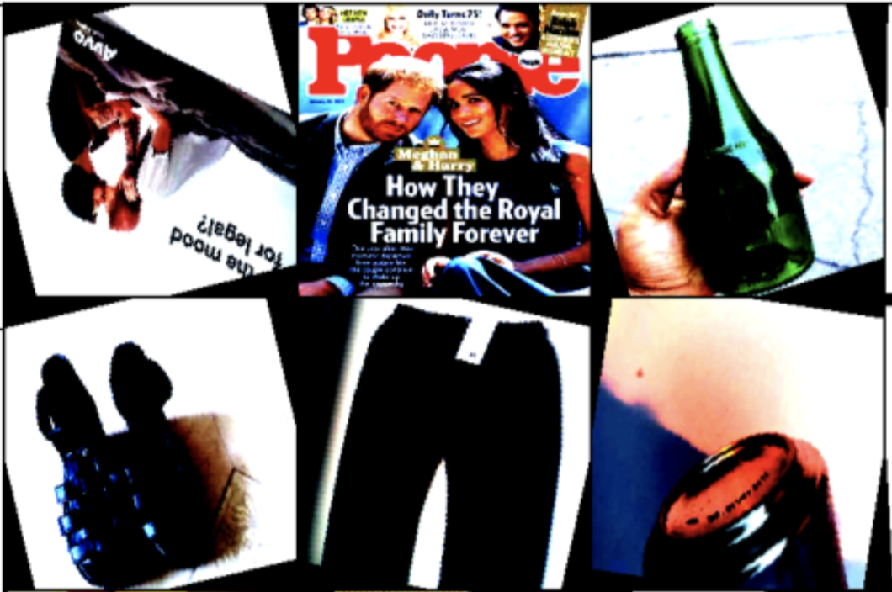
Image Preparation
resized to be 224x224
normalization
randomly flip or rotate
rebalance class distribution when sampling
Notes:
Random flipping: encourage generalization & avoid overfitting by including diversity in the data through random noise
This dataset had some class imbalances with clothing and shoes taking up more than a third of the dataset. To minimize the effect of this, ImbalancedDatasetSampler was used when loading the data into batches.

Slide 7
Model we used
Transfer Learning
3 CNN models: VGGNet-16, ResNet-50, MobileNetV2
pre-trained on the ImageNet dataset (1000 object classes)
unfreeze the parameters of the last layer for fine tuning
fine-tuned on our Household Garbage dataset with 12 classes
Notes:
All trained on the same dataset
These models were pre-trained on the ImageNet dataset containing over 14 million images across 1000 object classes. To fine-tune them, the last layer for each model was removed and retrained to fit the waste dataset.

Slide 8
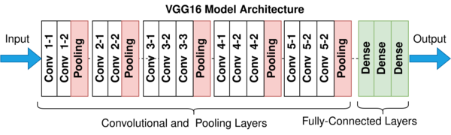
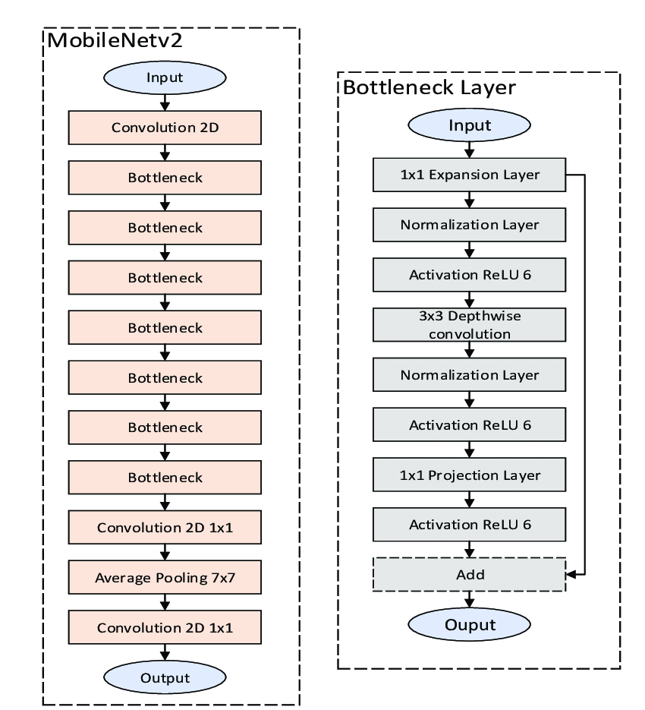
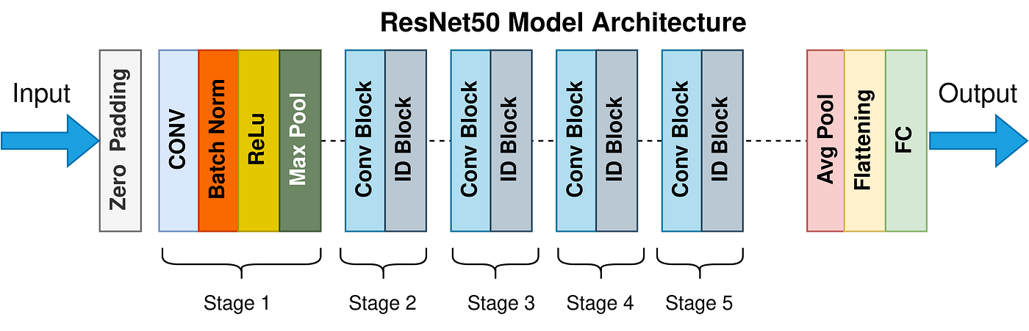

Slide 9
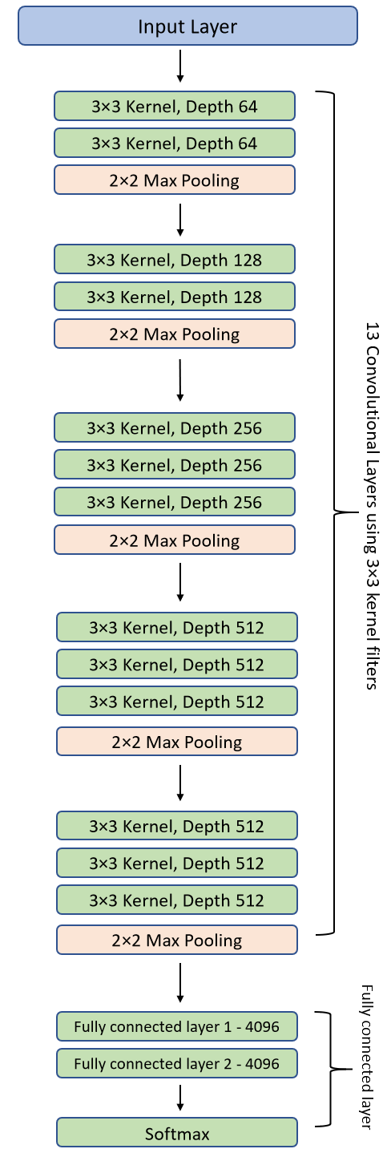
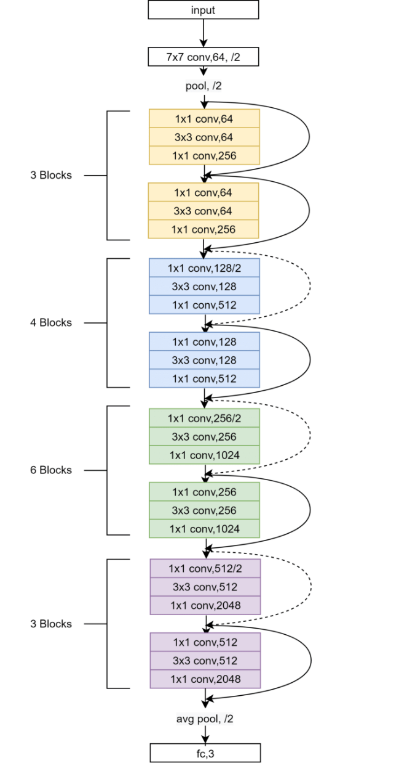

Slide 10
Model we used
VGGNet-16
16 layers
3x3 filters
138 million parameters
5*10e4 trainable parameters
ResNet-50
50 layers
batch normalization
skip-connections
residual blocks
24.6 million parameters
10e6 trainable parameters
MobileNet v2
53 layers
bottleneck layers
for mobile applications
3.5 million parameters
10e6 trainable parameters
Notes:
https://paperswithcode.com/method/resnet
https://paperswithcode.com/method/mobilenetv2
….. Trainable parameters in the last layers

Slide 11
Model we used
VGGNet-16
16 layers
3x3 filters
138 million parameters
5*10e4 trainable parameters
Notes:
https://paperswithcode.com/method/resnet
https://paperswithcode.com/method/mobilenetv2
….. Trainable parameters in the last layers

Slide 12
Model we used
VGGNet-16
16 layers
3x3 filters
138 million parameters
5*10e4 trainable parameters
ResNet-50
50 layers
batch normalization
skip-connections
residual blocks
24.6 million parameters
10e6 trainable parameters
MobileNet v2
53 layers
bottleneck layers
for mobile applications
3.5 million parameters
10e6 trainable parameters
Notes:
https://paperswithcode.com/method/resnet
https://paperswithcode.com/method/mobilenetv2
….. Trainable parameters in the last layers

Slide 13
Model we used
ResNet-50
50 layers
batch normalization
skip-connections
residual blocks
24.6 million parameters
10e6 trainable parameters
Notes:
https://paperswithcode.com/method/resnet
https://paperswithcode.com/method/mobilenetv2
….. Trainable parameters in the last layers

Slide 14
Model we used
VGGNet-16
16 layers
3x3 filters
138 million parameters
5*10e4 trainable parameters
ResNet-50
50 layers
batch normalization
skip-connections
residual blocks
24.6 million parameters
10e6 trainable parameters
MobileNet v2
53 layers
bottleneck layers
for mobile applications
3.5 million parameters
10e6 trainable parameters
Notes:
https://paperswithcode.com/method/resnet
https://paperswithcode.com/method/mobilenetv2
….. Trainable parameters in the last layers

Slide 15
Model we used
MobileNet v2
53 layers
bottleneck layers
for mobile applications
3.5 million parameters
10e6 trainable parameters
Notes:
https://paperswithcode.com/method/resnet
https://paperswithcode.com/method/mobilenetv2
….. Trainable parameters in the last layers

Slide 16
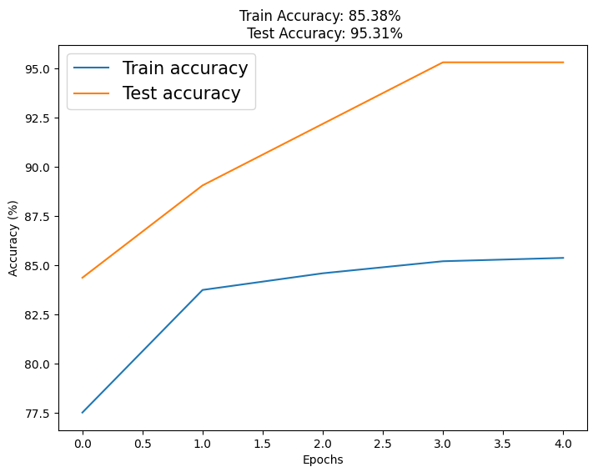
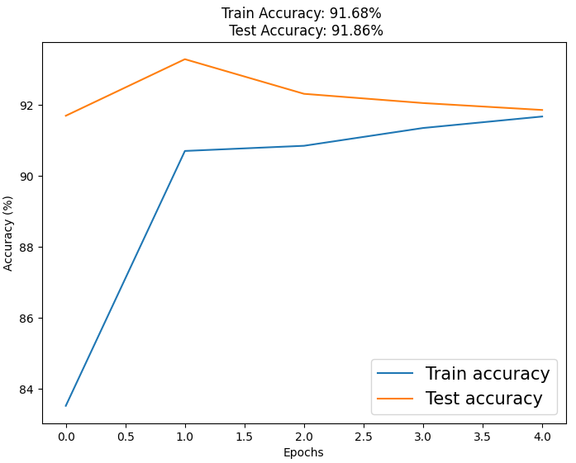
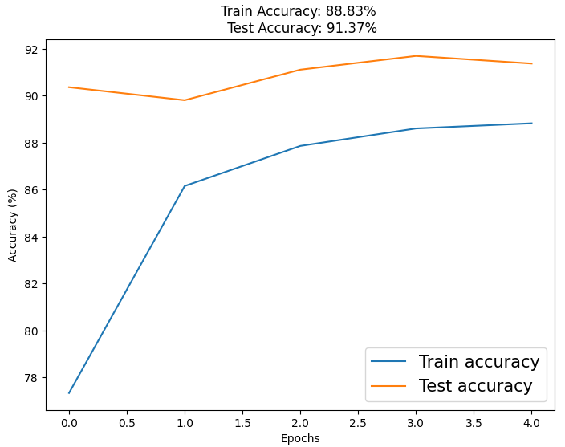
Result
batch size of 64, 5 epochs, Adam optimizer, learning rate of 0.001, cross entropy loss function
VGGNet-16
95.31% accuracy
ResNet-50
91.86% accuracy
MobileNet v2
91.37% accuracy

Slide 17
Conclusion and Future works
Our best model has comparable results with previous findings
Future work: include more types of recycling, e-waste and organic materials
Model | Categories | Accuracy
ConvoWaste | 6 | 98%
Resin Code Identifier | 5 | 99.7%
Organic Waste Classifier | 2 | 96.6%
Household Waste Classifier | 12 | 95.31%

